Slide 1
Dendritic action potentials and computation in human layer 2/3 cortical neurons
by Albert Gidon, Timothy Adam Zolnik, Pawel Fidzinski, Felix Bolduan, Athanasia Papoutsi, Panayiota Poirazi, Martin Holtkamp, Imre Vida, and Matthew Evan Larkum

Slide 2
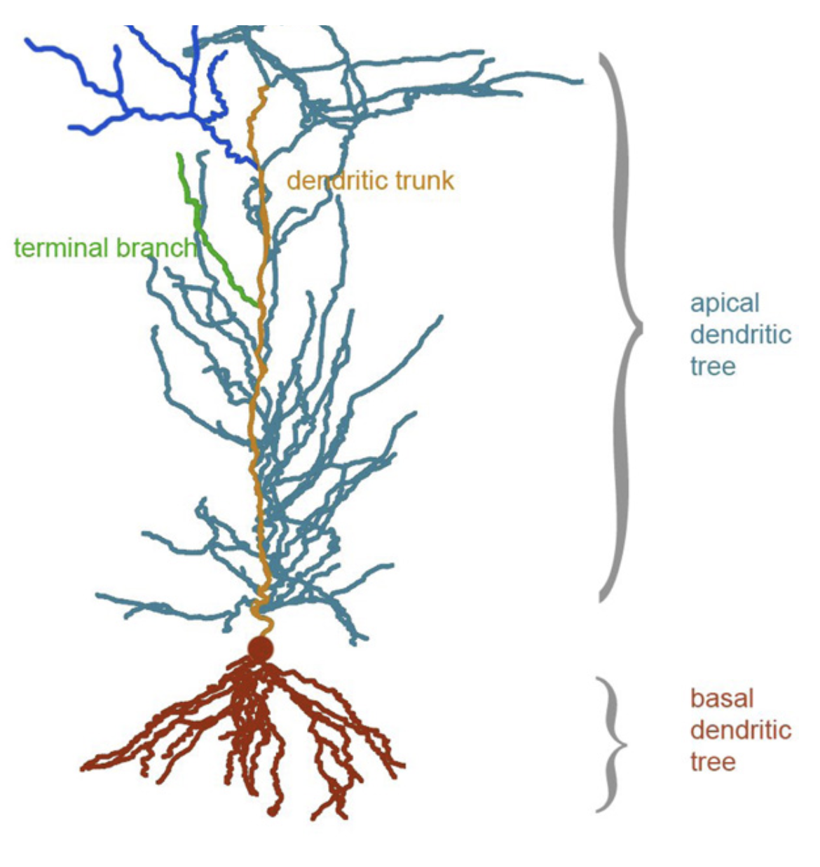
Dendritic computation?
Dendrites = branched extensions of a neuron which receive electrical signals and transfer signals to cell body (soma).
Majority of the surface area of neurons
Active neuronal structures, generate their own action potentials.
Neuronal communication, memory and learning; major factor in long term potentiation (LTP)
From: Kastellakis G, Cai DJ, Mednick SC, Silva AJ, Poirazi P. Synaptic clustering within dendrites: an emerging theory of memory formation. Prog Neurobiol. 2015;126:19–35. doi:10.1016/j.pneurobio.2014.12.002
Notes:
APs in soma usually travel down the axon away from soma but can backpropagate into the dendrite causing dendritic spikes – gives information to the synapse that the neuron has fired an output.
Most synapses are made onto dendrites so their properties determine how synaptic inputs are integrated before they can influence action potential output of neurons

Slide 3
Motivations and methods
Most knowledge from rodent models
Here, human cells from brain slices of L2/L3 cortical pyramidal neurons were investigated
Somatodendritic patch clamp recordings.
Injected current into soma and different dendritic sites and recorded membrane potential in both sites to record any resulting action potentials (APs)
Notes:
human brain has a disproportionate thickening of L2/L3 cortical neurons
Investigation into dendritic physiology of layer 2/3 pyramidal neurons in slices taken from surgically resected brain tissue from epilepsy patients.

Slide 4
Results
Recorded two kinds of action potentials in human pyramidal dendrites.
One of these APs was a new calcium-mediated dendritic action potential.
These calcium mediated APs are graded and finely tuned to input strength.
Computational model demonstrated anti-coincident properties and was able to classify linearly nonseparable inputs.

Slide 5
Results
Recorded two kinds of action potentials (APs) in human L2/L3 dendrites:
As a result of backpropagation from somatic APs

Slide 6
a) As a result of backpropagation from somatic APs
Backpropagating APs (bAPs)
Notes:
iii = bAPs in 16 dendrites and green is their average trace

Slide 7
Results
Observed action potentials (APs) in human L2/L3 dendrites:
As a result of backpropagation from somatic APs
Calcium mediated dendritic APs
Previously observed in animal models: attributed to Na⁺ channels and/or NMDA
Here observed to be blocked by Ca²⁺ channel blockers

Slide 8
A new kind of dendritic AP?
a) Backpropagating Aps (bAPs)
b) Calcium-mediated dendritic APs (dCaAPs)
Notes:
Iii in b = initial dCaAP in each recording at threshold in the same 16 dendrites + average trace
amplitudes not dependent on distance = consistent with variability of initiation site

Slide 9
Results
Observed action potentials (APs) in human L2/L3 dendrites:
As a result of backpropagation from somatic APs
Uncoupled from somatic APs
2. dCaAPs are sharply tuned to a particular input strength

Slide 10
A new kind of dendritic AP?
2. dCaAPs are sharply tuned
Somatic APs do not demonstrate the same sharp tuning
Notes:
Dendritic activation function = amplitude of dCaAPs as a function of the intensity of current injection in dendrite
Activation function reached maximum at rheobase where Irhe = threshold current for triggering dCaAP and decayed for stronger Idend - this is from 12 uncoupled dCaAPs

Slide 11
Results
Observed action potentials (APs) in human L2/L3 dendrites:
As a result of backpropagation from somatic APs
Uncoupled from somatic APs
dCaAPs are sharply tuned to a particular input strength
3. Computational model of L2/L3 neuron exhibits anti-coincident properties.

Slide 12
Computational model
Compartmental model of a L2/L3 pyramidal neuron
Replicate dCaAP behavior in dendrites
Morphology digitally reconstructed and modelled in NEURON simulation environment
Reconstructed L2/L3 neuron morphology with:
Somatic compartment
101 basal dendritic sections
81 apical tree sections
Axonal cable (1000 μm length, 1 μm diameter)
dCaAP’s threshold, width and amplitude as a function of input strength simulated by the sum of current sources with sigmoidal shape.

Slide 13
Computational model
Simulated two distinct classes of input:
Pathways X and Y with 25 excitatory synapses for each pathway, targeting a subregion of the apical dendrite
Inhibitory pathway with 20 GABAergic synapses

Slide 14
3. Computational model exhibits anti-coincident properties
1. Pathways X and Y both able to trigger dCaAPs by themselves
2. Coincident activation of pathways (X + Y) results in diminished dCaAP amplitude

Slide 15
3. Computational model exhibits anti-coincident properties
1. Pathways X and Y both able to trigger dCaAPs by themselves
2. Coincident activation of pathways (X + Y) results in diminished dCaAP amplitude
Precise balance between excitation and inhibition essential for generation of dCaAPs
Counterintuitive role for inhibition
3. Inclusion of inhibiting pathway (20 GABAergic synapses; X + Y + inhib) repolarised membrane

Slide 16
XOR Classification problem
Input |  | Output
A | B
0 | 0 | 0
0 | 1 | 1
1 | 0 | 1
1 | 1 | 0
XOR = exclusive-or
Logical operation which outputs true when inputs differ
Non-linearly separable

Slide 17
Dendrites perform XOR operation?
Activation function
Point neurons: dendritic inputs summed, can only compute logical operations such as AND and OR
XOR requires network solution
dCaAPs activation function: computes XOR operation by suppressing the amplitude of the dCaAP when the input is above the optimal strength
Considered a model where:
XOR operation performed in the dendrites with dCaAPs
AND/OR operations performed at the soma

Slide 18
Conclusions
Knowledge of active dendrites thus far has come from rodent studies.
Here, investigation into dendrites of human layer 2/3 pyramidal neurons revealed calcium-mediated dendritic action potentials not previously described.
dCaAPs are graded and finely tuned.
A computational model demonstrated anti-coincident properties and was able to classify linearly nonseparable inputs and perform an XOR operation.

Slide 19
Questions?

Slide 20
Fig 1

Slide 21
Fig 2

Slide 22
Fig 3

Slide 23
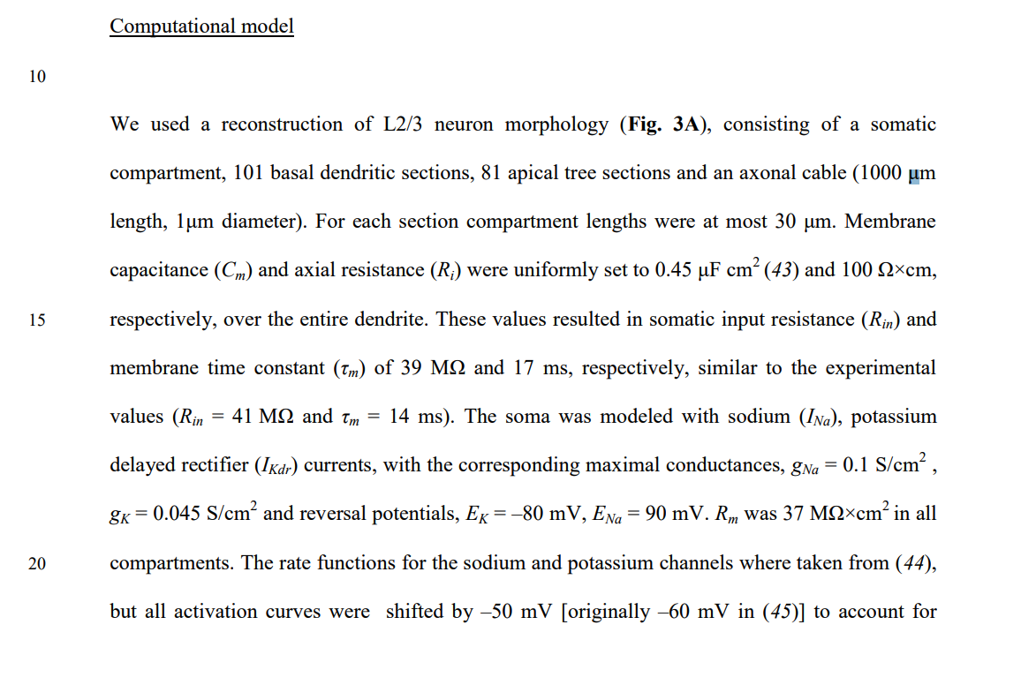
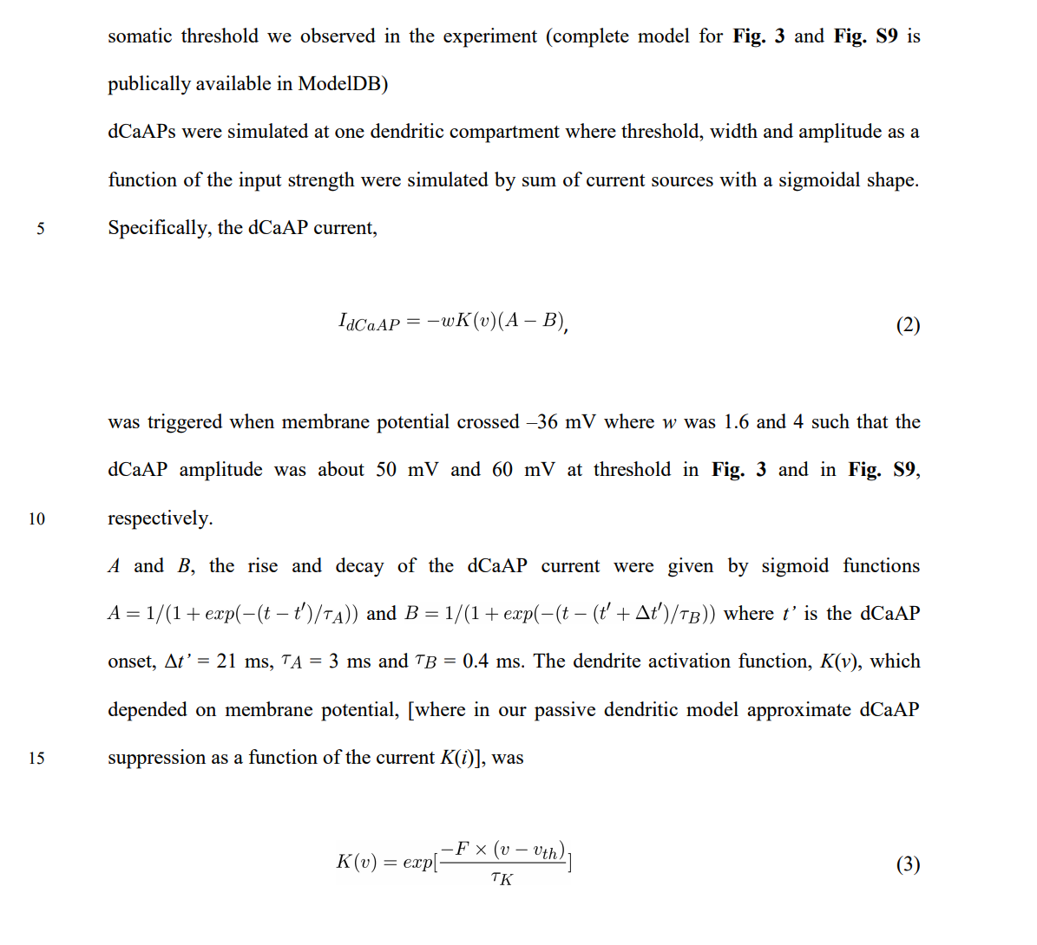

Slide 24
